Slide 1
Weekly Meeting 4/11/2024
JetRacer Soccer League

Slide 2
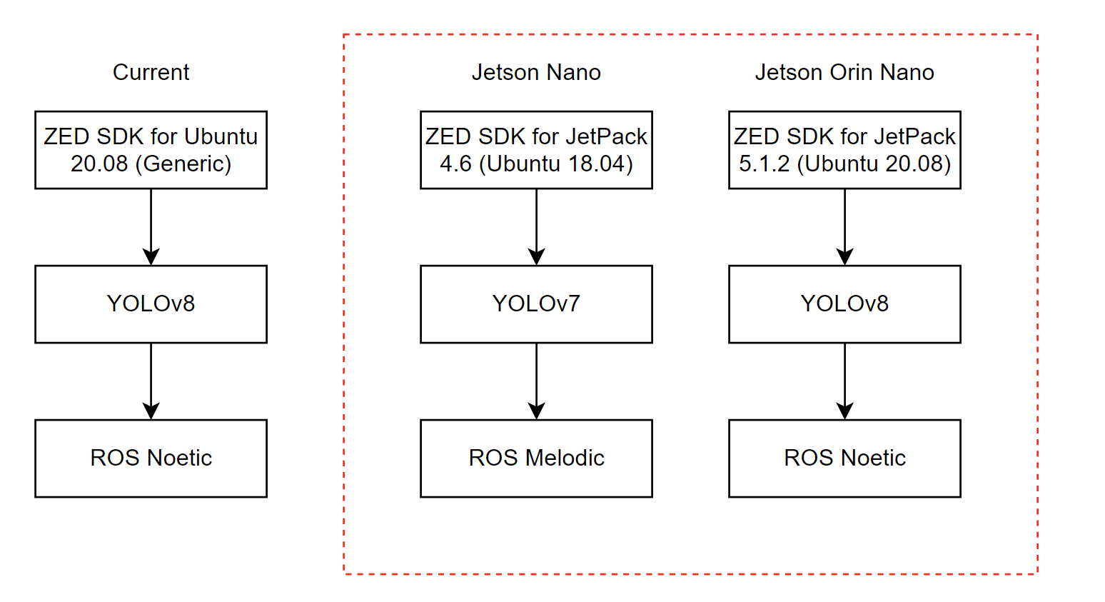
Software Versions

Slide 3
ROS
Previous Work:
Flashed SD card with Ubuntu 20.04
Installed ROS noetic
Attempted to install ZED 2 SDK
Researched Docker and JetPack
Created plan to implement Orin Nano
Future Work:
Continue to work with ZED SDK
Use Docker containers for package management
Purchase and install Orin Nano

Slide 4
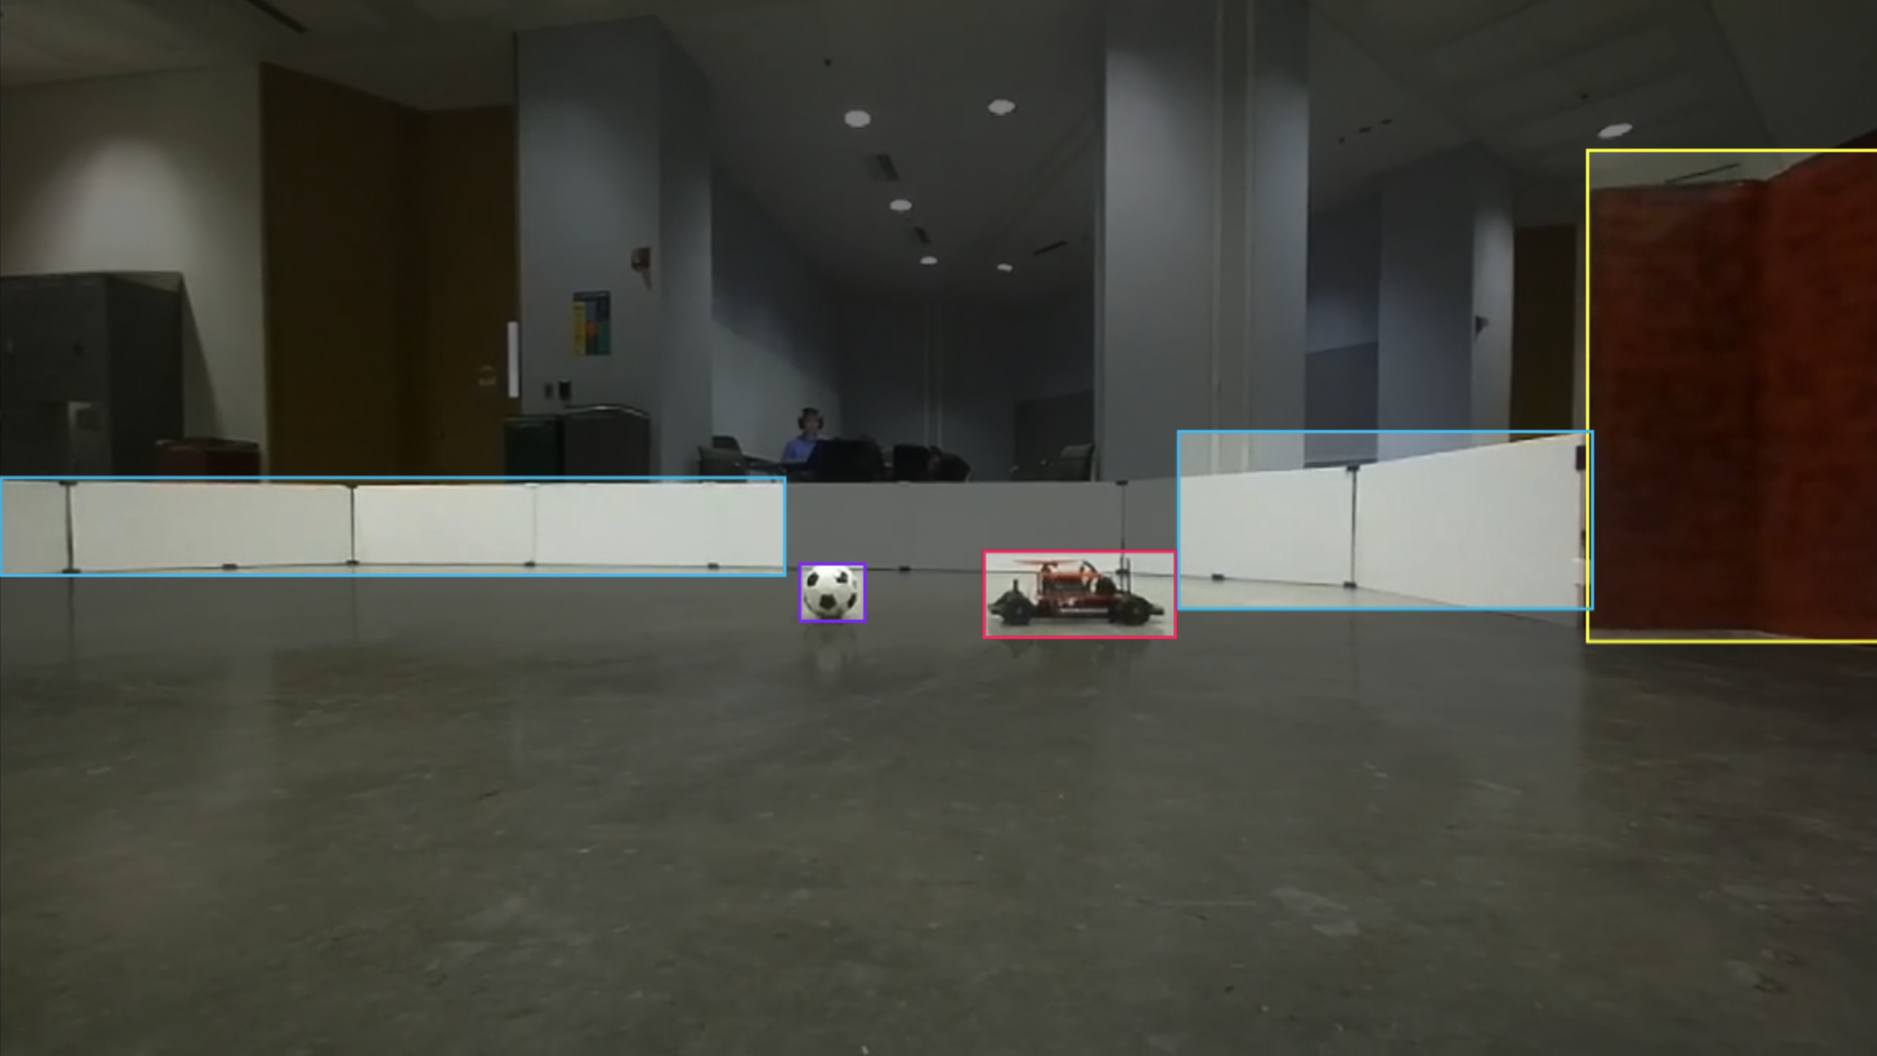
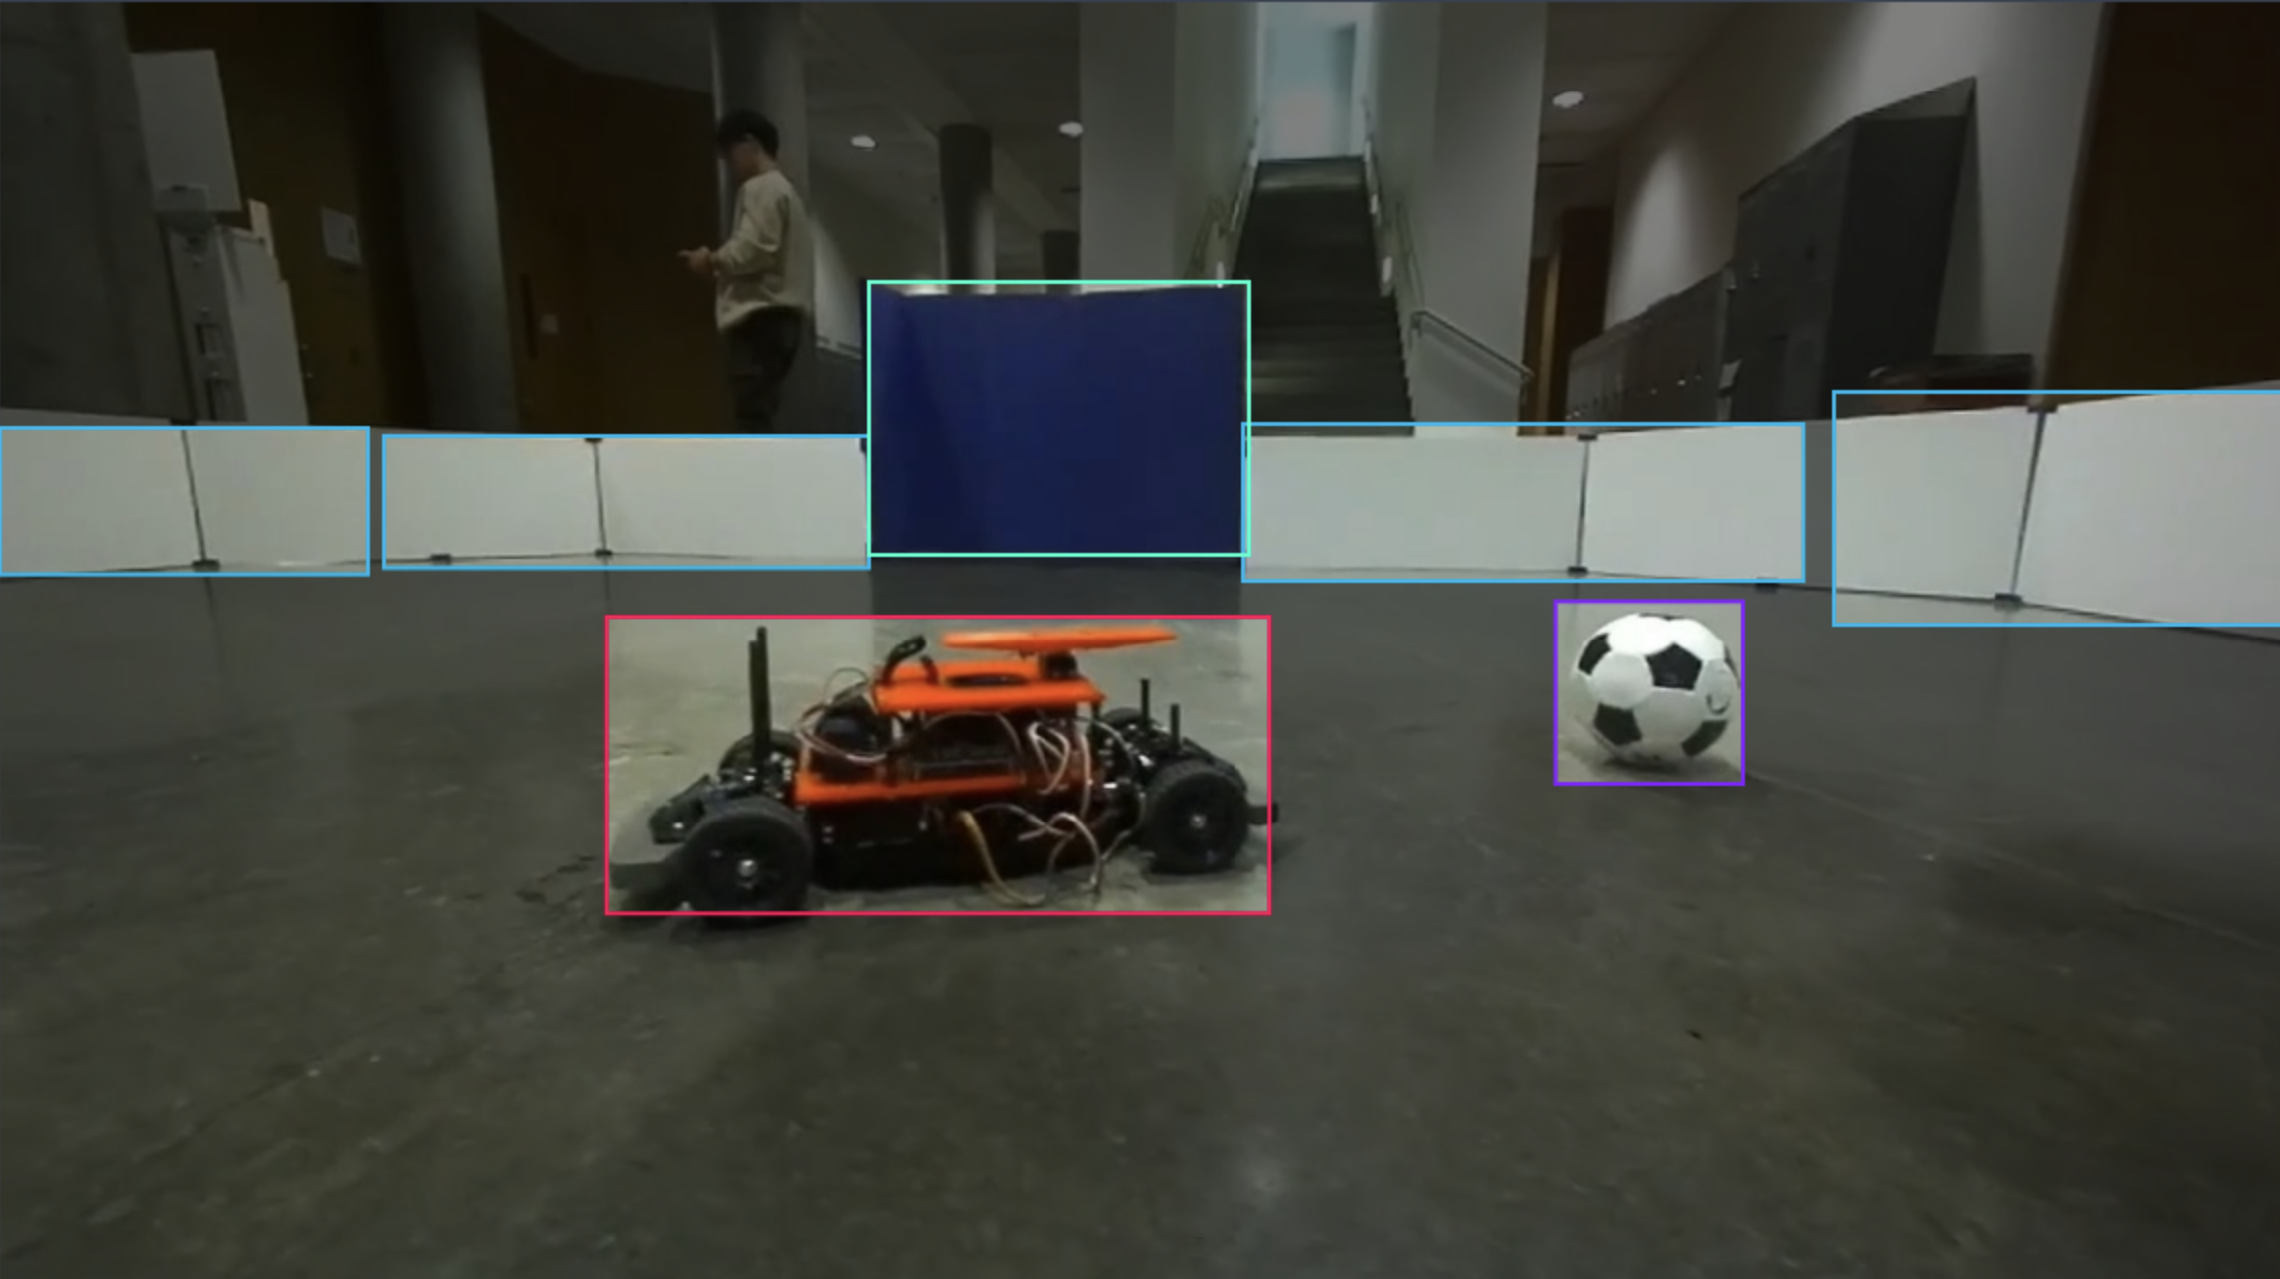
CV
Previous work:
Annotated the 660 photos on the dataset and started training the dataset.
Future work:
Test out new CV with yolov8 and check if object detection needs more training
Record more videos and annotate more pictures with the blue car

Slide 5
Red Car
Blue Car
Current:
Red 3D printed mounts and servo motor
ZED
Future:
Jetson Orin Nano
Current:
No hardware
Future:
Jetson Orin Nano
ZED
Blue 3D printed mounts and servo motor
Need to record video and annotate dataset

